Slide 1

Mississippi State Fire Marshal’s Office
Smoke Alarm Installation Training
Tammy L. Peavy
Fire Safety Education Officer

Slide 2
Advertising
NO give aways-alarms MUST be installed
Newspaper
Radio
TV
Flyers
Sign in sheets
Applications
Door-to-door
Word of mouth

Slide 3
Make a date
Residents are home
Assistant/caregiver is present
Translator is present

Slide 4
Interacting with Residents
Address by formal name (Mr., Ms., Mrs., etc.)
Identify yourself clearly
Wear a name badge
OR wear organization clothing
OR go in a marked vehicle
Be persuasive, but respect person’s right to say “no”

Slide 5
Social Etiquette
Tips for installers who work with people with disabilities

Slide 6
General Tips
Use “people first” language
Never say “handicapped” or “special”
Never touch or distract a service animal without prior permission
Avoid making assumptions
Don’t be afraid to ask questions.
Try to give people with disabilities options

Slide 7
General Tips
Disregard the idea that you are saving people with disabilities
A few simple guidelines
Treat adults as adults
Don’t be embarrassed if you use common expressions
Make eye contact with the person who is deaf rather than the translator

Slide 8
Who gets conventional smoke alarms?
Owner-occupied homes
No rental property
No businesses
No churches

Slide 9
Who gets conventional smoke alarms?
Owner-occupied homes
Low income families
Older adults
Families with children under 14 years old
People with disabilities

Slide 10
Recommendations
Remove smoke alarms that are 10 or more years old
Remove non-working smoke alarms
Residents have qualified electrician remove or replace existing hardwired smoke alarms-DO NOT remove them

Slide 11
Conventional Smoke Alarms
ONLY use alarms provided by the State Fire Marshal’s Office. Do NOT supplement the program with other alarms.
10-year lithium power pack
No need to replace batteries
Sealed alarm
Power pack cannot be unplugged or removed
Power pack will not fit other devices

Slide 12
Conventional Smoke Alarms
Alarm activates when power cell inserted
Test/silence button
Used to test alarm
Allows resident to silence nuisance alarms
Silences alarm for 10 minutes unless smoke conditions persist

Slide 13
Testing and Maintenance
Show residents how to test the smoke alarms
Instruct residents to test smoke alarms monthly
Instruct residents to clean smoke alarms monthly with vacuum cleaner soft brush attachment or duster
Show residents how to use the test/silence button
Leave the instructions from the package with the residents
After 10 years or when the alarm starts to chirp, residents should replace the alarm

Slide 14
Conventional Smoke Alarm Installation
Outside each sleeping area
Inside each sleeping room
On each level of the home, including basement
Areas separated by a door from the required locations

Slide 15
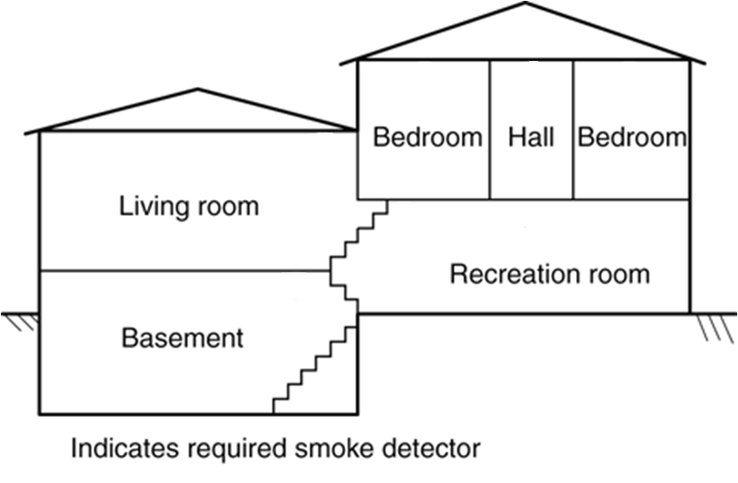
Conventional Smoke Alarm Installation

Slide 16
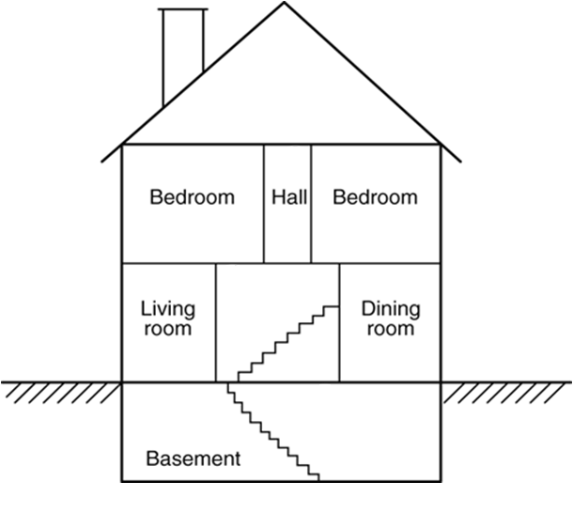
Conventional Smoke Alarm Installation

Slide 17
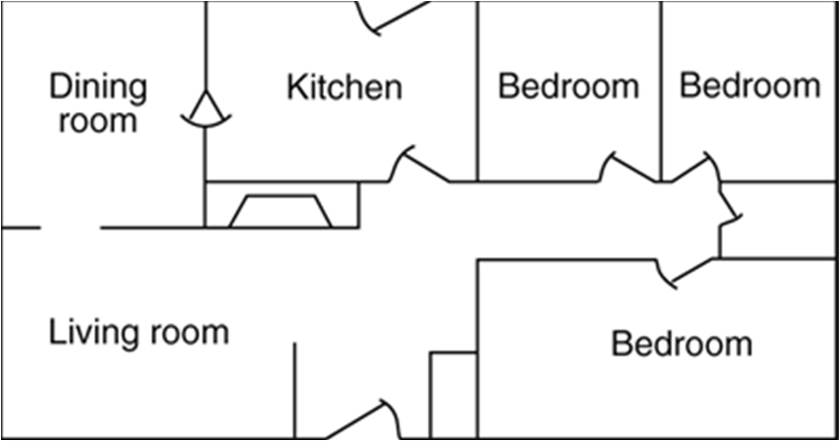
Conventional Smoke Alarm Installation

Slide 18
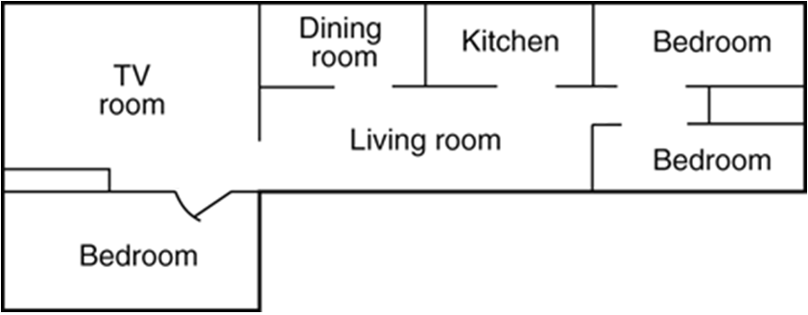
Conventional Smoke Alarm Installation

Slide 19
Conventional Smoke Alarm Installation
On ceiling
At least 4” from wall
-OR-
On wall
At least 4” from ceiling
Not more than 12” from ceiling

Slide 20
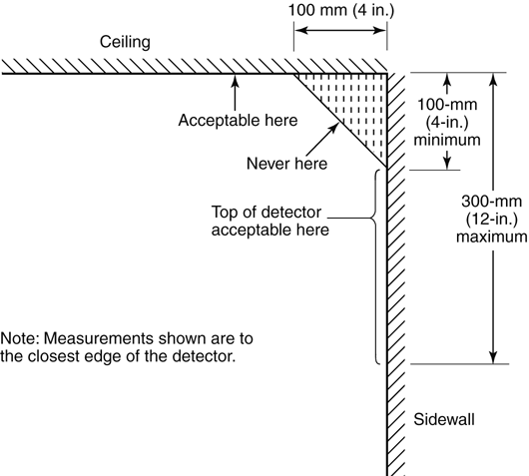
Conventional Smoke Alarm Installation
OR

Slide 21
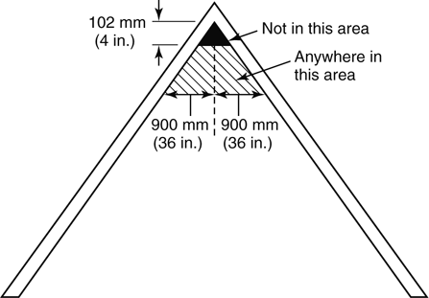
Conventional Smoke Alarm Installation

Slide 22
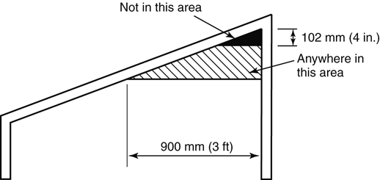
Conventional Smoke Alarm Installation

Slide 23
AVOID putting smoke alarms in
Kitchens
Garages
Bathrooms
Areas where temperature or humidity are outside manufacturer’s limits-not below 40°F or above 100°F (includes most attics)

Slide 24
AVOID putting smoke alarms
Where mounting surface could become too hot or too cold
Within 3’ of a bathroom or kitchen door
It is best to install smoke alarms at least 10’-12’ from cooking appliances, where possible
Within 3’ of a supply air register
Within 3’ of air flow path
Within 3’ of ceiling fan blade tips

Slide 25
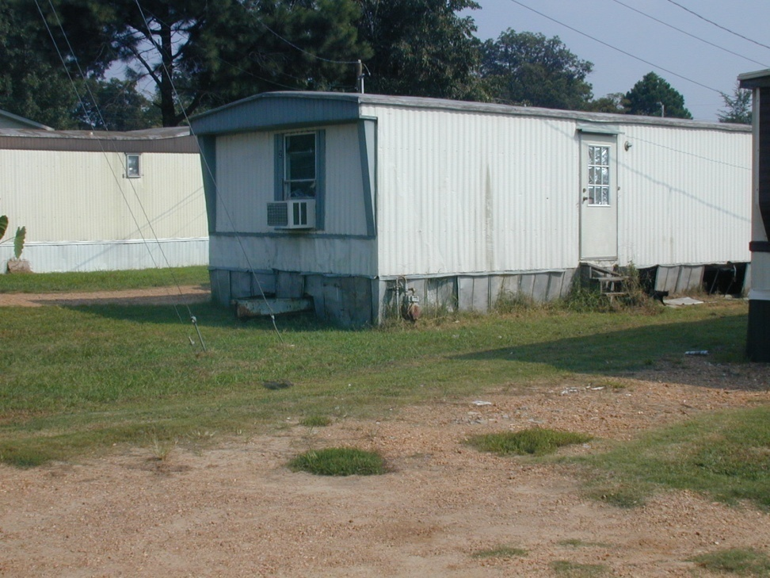
Mobile Homes
Many mobile homes built before 1978 have little or no insulation. In these homes or if you are unsure of the age, install smoke alarms on the interior walls only.

Slide 26
Who gets a SafeAwake alert device?
People who are deaf
People who are hard of hearing
Older adults
May be installed in rental property

Slide 27
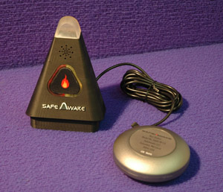
SafeAwake alert device
Activated by conventional smoke alarm T-3 alarm pattern
Emits a high-decibel, low frequency audible signal
White flashing light
Bed shaker
Battery back-up
Use only CR-123
lithium batteries
Portable-take it with
you when you travel

Slide 28
SafeAwake alert device
Red light
bed shaker unplugged
Yellow light
batteries low
Green light
Solid-on AC power
Flashing-on battery power

Slide 29
SafeAwake Testing
Show resident how to test the SafeAwake alarm
Instruct resident to test alarm monthly
Alarm will alert 30 seconds when triangular button is pressed
Alarm will alert 2 minutes when conventional smoke alarm is tested for full T-3 signal
Leave the instructions from the package with the resident

Slide 30
SafeAwake Installation
In every room where a person who is deaf or hard of hearing sleeps
Also install a conventional smoke alarm in this room

Slide 31
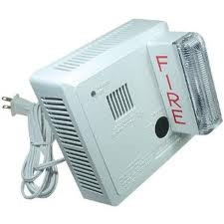
Who gets a Gentex alarm?
People who are deaf
May be installed in
rental property

Slide 32
Gentex Alarm
Photo-electric
Strobe light
High frequency audible signal
Battery back up
Does not operate strobe

Slide 33
Gentex Alarm Testing
Show residents how to test the smoke alarm
Turn knob to TEST 1, wait 20 seconds for sound and flash
Turn knob to NORMAL, wait 20 seconds for sound and flashing to stop
Instruct residents to test smoke alarm monthly
Instruct residents to clean smoke alarm monthly with vacuum cleaner soft brush attachment or duster
Leave the instructions from the package with the residents

Slide 34
Gentex Installation
In living room/common area near wall outlet that is not controlled by an on/off switch
In any room frequently occupied by a person who is deaf
Office
Den

Slide 35
Provide fire safety and escape planning information
Review all educational handouts with the residents
A fire safety DVD will be provided to people who are deaf or hard of hearing

Slide 36
Installer Responsibilities
Install alarms according to the Mississippi Fire Marshal’s Office guidelines
Complete a survey/waiver form for each home visited
Every week, mail or deliver all forms to your smoke alarm coordinator

Slide 37
Distribution
Each organization must have a smoke alarm coordinator
Must return forms showing installation before more alarms distributed
Pick up alarms at distribution point
Delivery may be possible

Slide 38
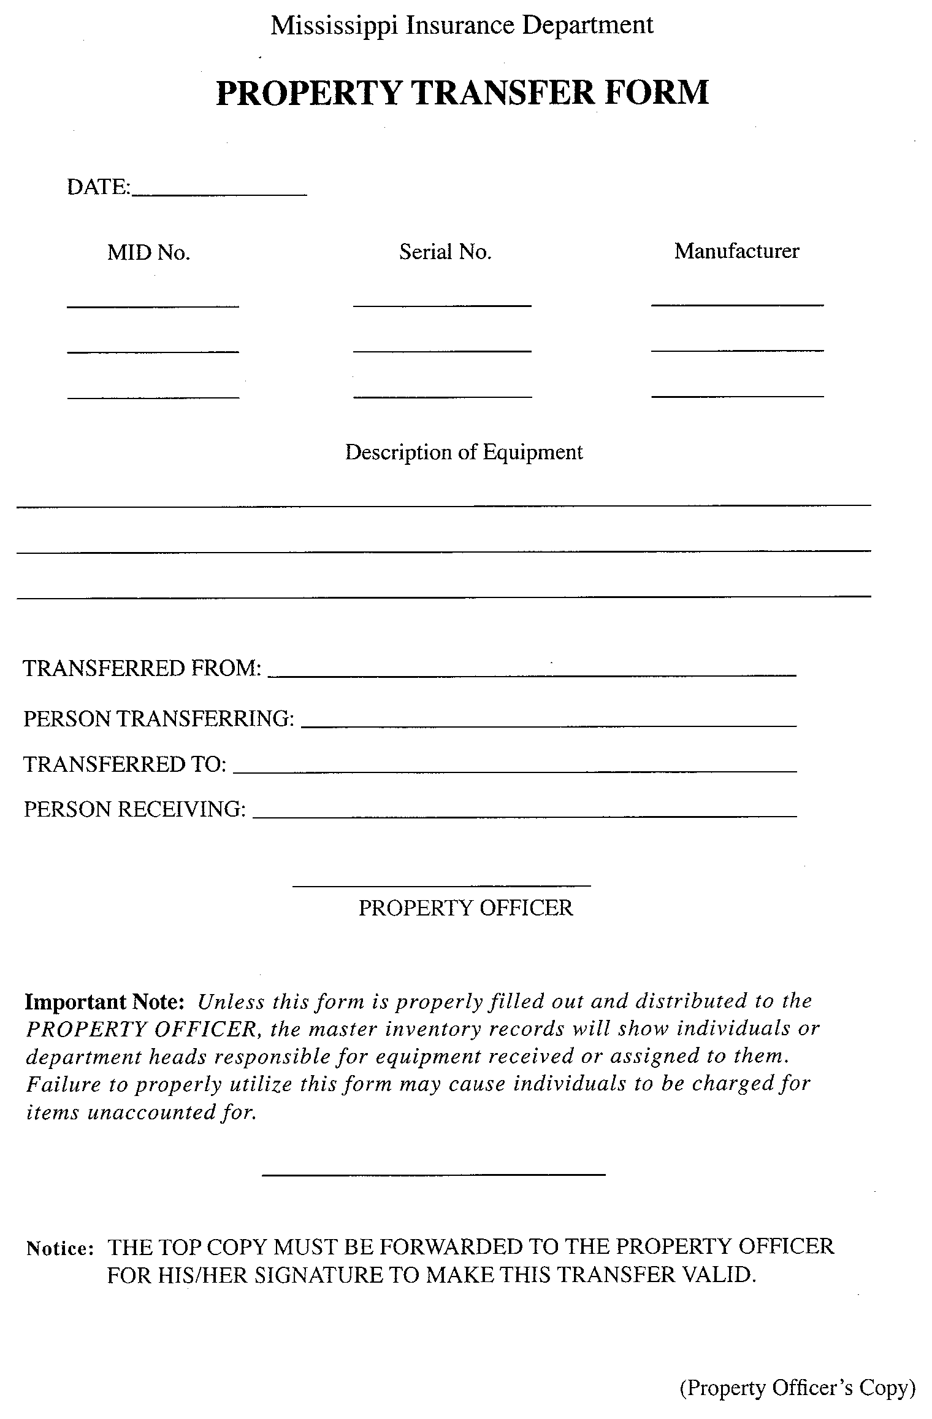
Transfer form

Slide 39
Transfer
Form must be completed when receiving/distributing alarms
Organization should track number of alarms distributed to each installer

Slide 40
Forms
Only use forms provided by the State Fire Marshal’s Office-no copies
NO pencils
NO red ink
Write legibly
Check spelling
Do NOT abbreviate organization name

Slide 41
Corrections
Draw a single line through the error, and write the correct information above, below, or to the side
If you check the wrong box, circle the correct answer
Incomplete forms will be returned

Slide 42
Waiver Complete 1 per HOUSE

Slide 43
Name of organization

Slide 44
Name of community

Slide 45
Physical address
Same as on front of form

Slide 46
PRINT name
If resident’s writing is illegible, print name for them
Have resident sign form
MUST be over 18
Date of installation

Slide 47
If resident is unable to write, have them mark “X”
Write “His/Her Mark” beside “X”
Print name
His mark-John Smith X

Slide 48
PRINT name
CANNOT be same as resident
Sign
Date of installation

Slide 49
Survey* Complete 1 per HOUSE *Some forms vary

Slide 50
Date of installation

Slide 51
Person installing alarms
Same on all forms
NOT organization

Slide 52
Do NOT leave blank

Slide 53
Include City, State, Zip Code
Use correct zip code
NO P. O. Boxes
NO Route/Box addresses
If more than one house at same address, write Second House on form

Slide 54
If same as physical address, write Same as above
Include City, State, Zip Code
Use correct zip code
NO Route/Box addresses
If more than one house at same address, write Second House on form

Slide 55
Only used for evaluation
NOT all residents will receive an email

Slide 56
Include area code
Only used for evaluation
NOT all residents will receive a call

Slide 57
County where home is located

Slide 58
Do not leave blanks
Use “0” or “N/A”

Slide 59
Permanent residents
NOT people who frequently say overnight

Slide 60
Over age 65
NOT the age

Slide 61
14 years or younger
NOT the age

Slide 62
Disabilities that would make escape difficult or impossible
Do NOT include deaf or hard of hearing

Slide 63
Number of people who are deaf

Slide 64
Number of people who are hard of hearing

Slide 65
Number of floors/ stories

Slide 66
Number of smoke alarms BEFORE you installed
If “NO”, skip questions 12-18

Slide 67
If there is only 1 level and 1 existing smoke alarm, this should be “YES”
If yes, skip #13

Slide 68
The lowest level of the home above ground is the first floor

Slide 69
A sleeping area is a room or group of rooms where people sleep

Slide 70
Include rooms that are not “bed” rooms

Slide 71
Does not include the alarms you install

Slide 72
You MUST test all existing alarms
If you did not, explain why not

Slide 73
CANNOT be more than #11

Slide 74
Number of First Alert smoke alarms installed

Slide 75
Number of Kidde smoke alarms installed

Slide 76
Number of SafeAwake alarms installed

Slide 77
Number of Gentex alarms installed

Slide 78
This is required!
If no, note why you did not

Slide 79
This is required!
If no, note why you did not

Slide 80
Number of people talked to about handouts

Slide 81
Questions?

